Slide 1
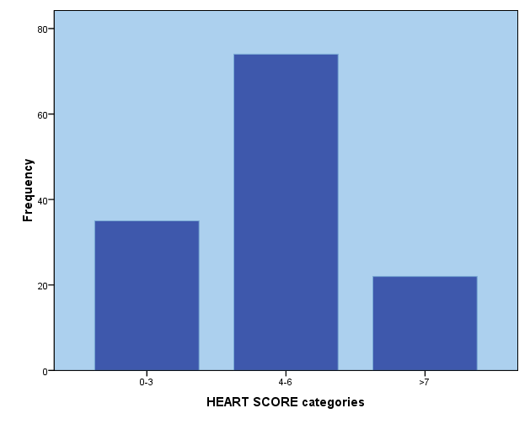
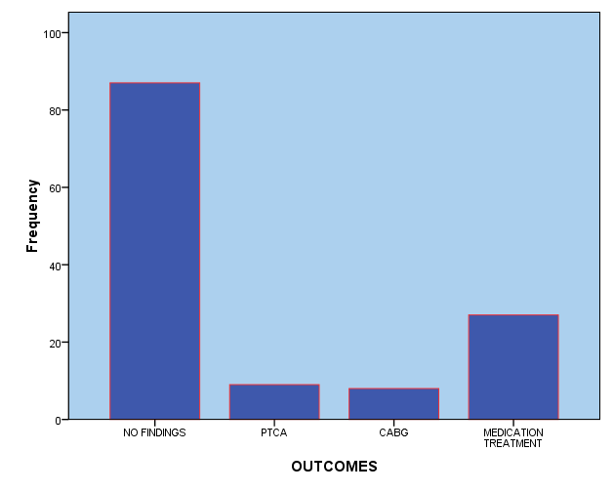
The effectiveness of the HEART Score in reducing health costs by predicting coronary artery disease and avoiding hospital admissions
I. Chiotelis ¹, E.Kletsiou ²,N. Kontogiannis ¹, LE. Poulimenos ¹, L. Plagisou¹, M.Koutsouradi ³, M.Kourakos ¹, E.Stamatopoulou² , D.Gkiafis ¹ , AJ. Manolis¹
1.Asklepieion General Hospital, Cardiology department Athens Greece, 2 . University General Hospital Attikon , Athens Greece
3. Metropolitan Hospital Piraeus, Greece
Introduction The challenge in the emergency department is not only to identify high risk patients but also to identify patients who can be safely discharged home. The HEART score predicts the short-term incidence of major adverse cardiac events, dividing patients with chest pain in three risk categories, by assigning zero, one, or two points towards 5 diagnostic criteria (Table 1)
Purpose of this study is to describe the population with chest pain, to characterize the subgroup of low-risk patients and to assess the prognostic value of HEART score in avoiding patients’ hospitalizations and reducing cost.
Table 1 : The HEART Score for Chest Pain Patients in the ED
History | Highly Suspicious Moderately Suspicious Slightly or Non-Suspicious | 2 points 1 point 0 points
ECG | Significant ST-Depression Nonspecific Repolarization Normal | 2 points 1 point 0 points
Age | ≥65 years >45- <65 years ≤45 years | 2 points 1 point 0 points
Risk Factors | ≥ 3 Risk Factors or History of CAD 1 or 2 Risk Factors No Risk Factors | 2 points 1 point 0 points
Troponin | ≥ 3 x Normal Limit >1 - < 3 x Normal Limit ≤ Normal Limit | 2 points 1 point 0 points
Risk Factors: DM, current or recent [<one month] smoker, HTN, HLP, family history of CAD, & obesity
Score 0-3: 2.5% MACE over next 6 weeks Discharge Home Score 4-6: 20.3% MACE over next 6 weeks Admit for clinical Observation Score 7-10: 72.7% MACE over next 6 weeks Early invasive Strategies
Six, Backus, and J C Kelder 2008
Methods
Retrospective observational study including patients admitted to the hospital after initial assessment in the emergency department of a tertiary hospital with chest pain as the presenting symptom. All the patients followed the diagnostic algorithm of chest pain.
Results
131 patients (65.4% males with mean age 64±13.6 years) admitted to hospital due to chest pain episode (Table 2).
The mean duration of hospitalization of the total sample was 2.8±1.9 days .
The mean HEART Score of all patients was 4.7±2 and 35 patients (26.7%) found to have low risk score 0-3, 74 (56.5%) with score 4-6 and 22 (16.8%) with high risk score ≥7 (Fig.1).
66.4% of the total sample had no findings as an outcome, and the rest 33.6% had coronary artery disease (Fig. 2).
Between the 3 score categories there was a statistical significant difference regarding the outcome (p=0.000).
Duration of the hospitalization was also positively correlated with the HEART Score (p<0.000, r=0.371).
Six, Backus, and J C Kelder 2008
Table 2: Description of the study population- Risk Factors
 | YES N (%) | NO N (%)
CAD | 47 (35.9) | 84 (64.1)
Hypertension | 86 (65.6) | 45 (34.4)
Dyslipidemia | 86 (55) | 45 (45)
Diabetes Mellitus | 27 (20.6) | 104 (79.4)
Smoking | 38 (29) | 93 (71)
Family History | 17 (13) | 114(87)
Obesity | 7 (5.3) | 124 (94.7)
Medium risk score
HEART SCORE CORELLATIONS
CAD | p=0.004
Outcome | p=0.000
Age | p=0.000
Hospitalization duration | p=o.000
Statistical Analysis was done with SPSS 18.0. Statistical significance was at p<0.05
Low risk score
Diagnosis of CAD
33,6%
N=35
26.7%
N=74
56.5%
High risk score
N=87
66.4%
N=22
16.8%
N=9
6.9%
N=8
6.1%
N=27
20.6%
Figure 1 :
Figure 2 :
The low-risk patients group (Table 3) were discharged after 2±1 days of hospitalization with 40% of the patients after no other intervention but clinical assessment, the 48.6% after a stress test and 11.4% after a coronary angiography.
Only 2 out of 35 patients in this group had coronary artery disease, meaning that it was safe to avoid hospitalization in 94.3% of the patients.
Direct cost of 1 day hospitalization according to National Healthcare System DRG’s, that could be saved, was 310 €/patient (total 10230 €), while, comparatively, stress test as outpatients clinics would be 14 times less.
Table 3: LOW RISK GROUP ANALYSIS 0-3 (N=35)
Hospitalization duration | 2±1 days
Intervention | None 40% | Stress Test 48.6% | Coro. Ang. 11,4%
Cost analysis (hospitalization cost) | 310 € /patient Total Cost 10230 €
Cost analysis if no admission | 22 €/ stress test Total Cost 726 €
Conclusions The HEART score may be a useful tool for evaluation of patients with chest pain and identify a low-risk group in which admission and further investigations may not be necessary in order to reduce cost, decrease the days in hospital and increase the quality of care.

